Slide 1

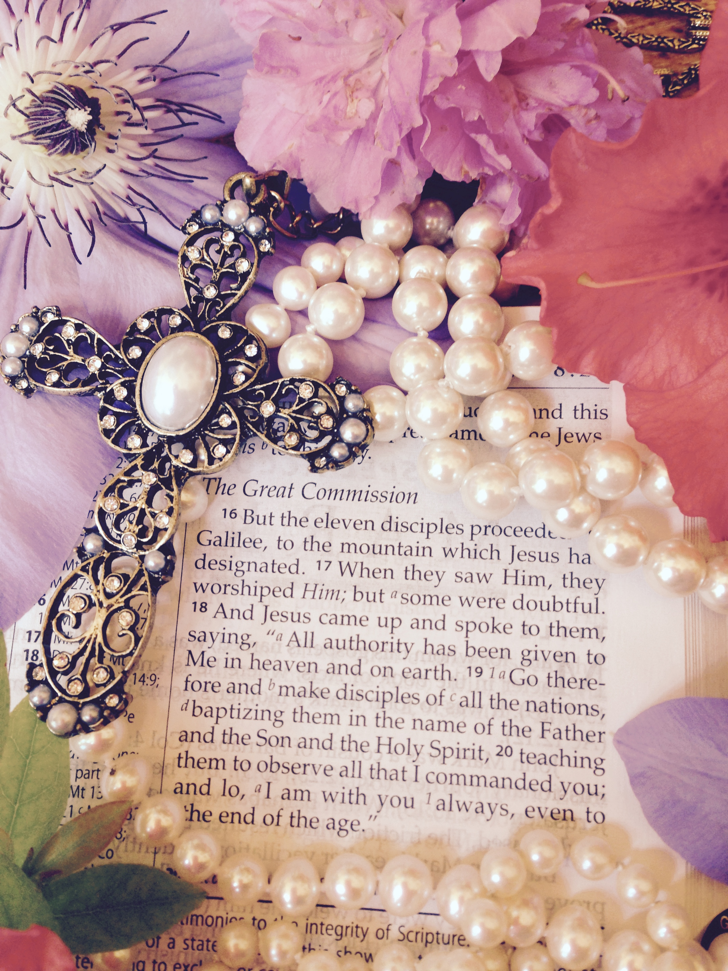
Make Disciples Of All Nations

Slide 2
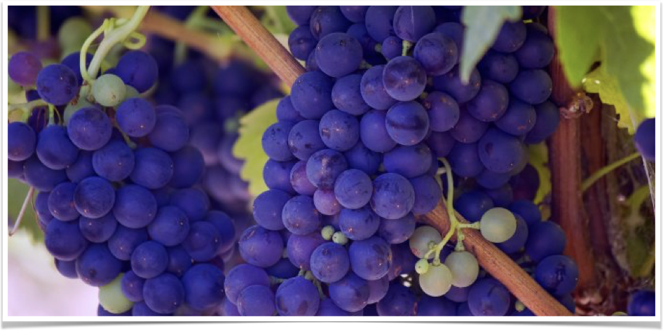
Be fruitful and Multiply

Slide 3
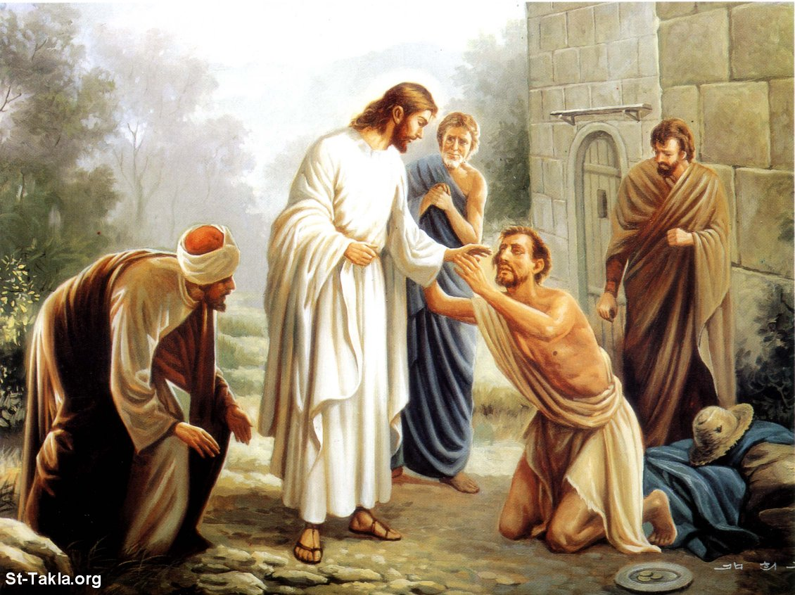
Disciple- making is embodied in Jesus’ Mission Statement
Luke 4:18-19

Slide 4
“1The Spirit of the Sovereign Lord is on me, because the Lord has anointed me to proclaim good news to the poor. He has sent me to bind up the brokenhearted, to proclaim freedom for the captives and release from darkness for the prisoners, 2to proclaim the year of the Lord’s favor and the day of vengeance of our God, to comfort all who mourn, 3and provide for those who grieve in Zion—to bestow on them a crown of beauty instead of ashes, the oil of joy instead of mourning, and a garment of praise instead of a spirit of despair. They will be called oaks of righteousness, a planting of the Lord for the display of his splendor. 4They will rebuild the ancient ruins and restore the places long devastated; they will renew the ruined cities that have been devastated for generations.”
–Isaiah 61:1-4

Slide 5
“5Strangers will shepherd your flocks; foreigners will work your fields and vineyards. 6And you will be called priests of the Lord, you will be named ministers of our God. You will feed on the wealth of nations, and in their riches you will boast. 7Instead of your shame you will receive a double portion, and instead of disgrace you will rejoice in your inheritance. And so you will inherit a double portion in your land, and everlasting joy will be yours. 8“For I, the Lord, love justice; I hate robbery and wrongdoing. In my faithfulness I will reward my people and make an everlasting covenant with them.”
–Isaiah 61:5-8

Slide 6
“9Their descendants will be known among the nations and their offspring among the peoples. All who see them will acknowledge that they are a people the Lord has blessed.” 10I delight greatly in the Lord; my soul rejoices in my God. For he has clothed me with garments of salvation and arrayed me in a robe of his righteousness, as a bridegroom adorns his head like a priest, and as a bride adorns herself with her jewels. 11For as the soil makes the sprout come up and a garden causes seeds to grow, so the Sovereign Lord will make righteousness and praise spring up before all nations.”
–Isaiah 61:9-11

Slide 7
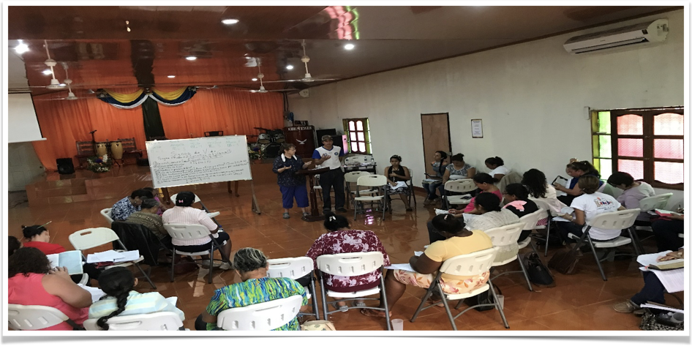
Juigalpa, nicaragua

Slide 8
“Until we all reach unity in the faith and in the knowledge of the Son of God and become mature, attaining to the whole measure of the fullness of Christ.”
–Ephesians 4:13

Slide 9
Disciple making leads to maturity, multiplication, and fruitful ministry
In Ephesians 4:13, the word mature is also translated as complete or, in King James, perfect man. Here is the definition: a complete labor, growth, mental or moral character, full age man, a perfect man and mature fruit.
Jesus used this word in His priestly prayer

Slide 10
“4I have brought you glory on earth by finishing the work you gave me to do.”
–John 17: 4

Slide 11
“As you sent me into the world, I have sent them into the world. 19For them I sanctify myself, that they too may be truly sanctified.20 “My prayer is not for them alone. I pray also for those who will believe in me through their message, 21that all of them may be one, Father, just as you are in me and I am in you. May they also be in us so that the world may believe that you have sent me. 22I have given them the glory that you gave me, that they may be one as we are one— 23I in them and you in me—so that they may be brought to complete unity. Then the world will know that you sent me and have loved them even as you have loved me.”
–John 17:18-23

Slide 12
Jesus used a derivative of the word from the cross when He said: It is finished! What was this Work? Redemption

Slide 13
Jesus’ Last Command to His Church
18Then Jesus came to them and said, “All authority in heaven and on earth has been given to me. 19Therefore go and make disciples of all nations, baptizing them in the name of the Father and of the Son and of the Holy Spirit, 20and teaching them to obey everything I have commanded you. And surely I am with you always, to the very end of the age.
–Matthew 28:18-20

Slide 14

When Jesus gave His disciples the Great Co-Mission, He handed them the baton…. His mission and ministry became theirs… Now it is ours

Slide 15
“You then, my son, be strong in the grace that is in Christ Jesus. 2And the things you have heard me say in the presence of many witnesses entrust to reliable people who will also be qualified to teach others.”
–2 Timothy 2:1-2

Slide 16
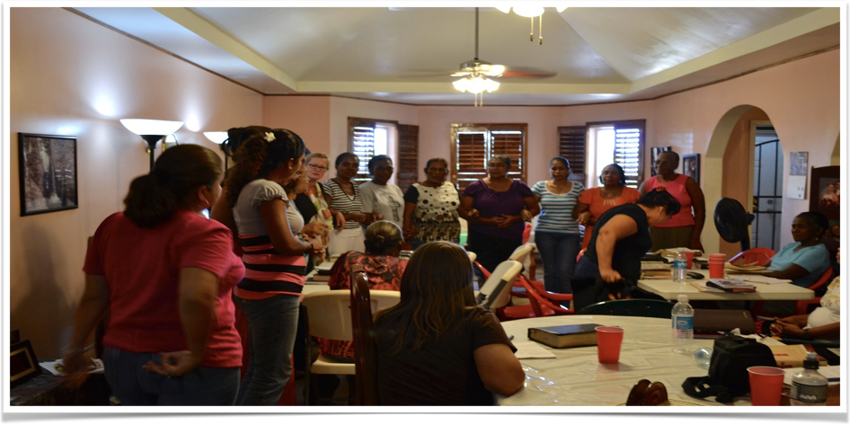
Multiplication Demonstration
Corn Island, Nicaragua

Slide 17
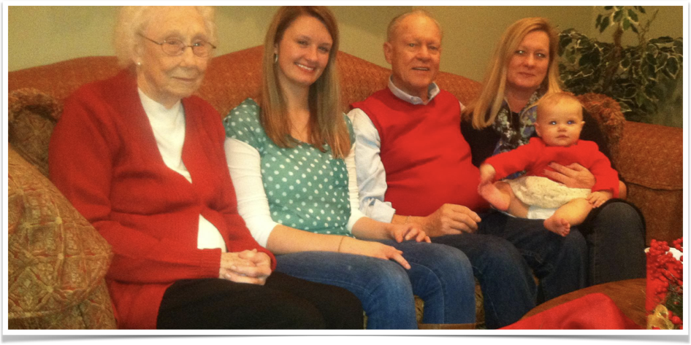
5 Generations

Slide 18
“16Therefore I urge you to imitate me. 17For this reason I have sent to you Timothy, my son whom I love, who is faithful in the Lord. He will remind you of my way of life in Christ Jesus, which agrees with what I teach everywhere in every church.”
–1 Corinthians 4: 16-17

Slide 19

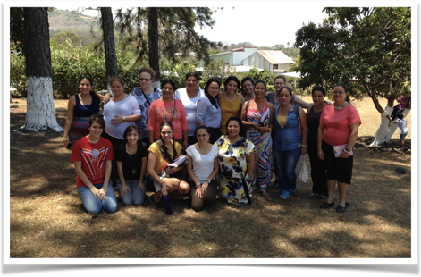
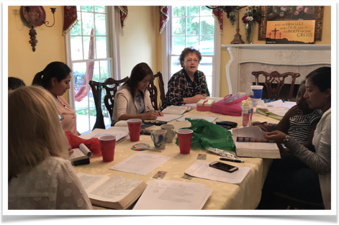

Slide 20
what strategy Did Paul employ
that catalyst missions
also uses?
To multiply you must find a F.A.T. person to invest in. One who is faithful, available, and teachable
The two key components of disciple-making are Truth and Life
A cell that does not multiply will die

Slide 21
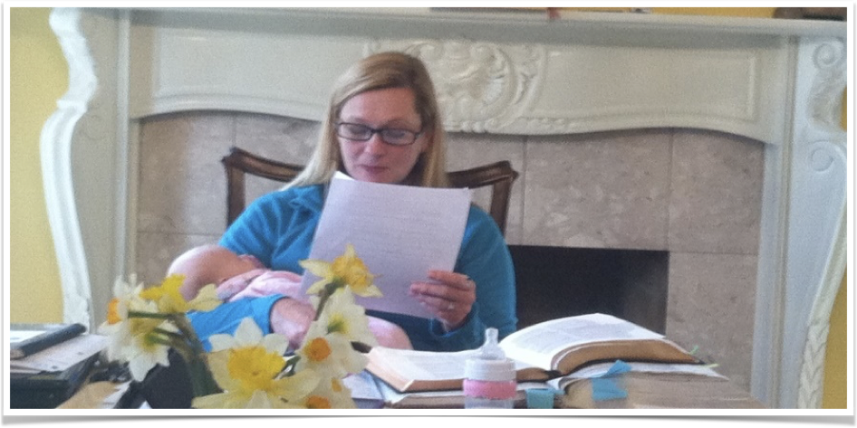
Making- disciples impacts everyone around you

Slide 22
“14But as for you, continue in what you have learned and have become convinced of, because you know those from whom you learned it, 15and how from infancy you have known the Holy Scriptures, which are able to make you wise for salvation through faith in Christ Jesus. 16All Scripture is God-breathed and is useful for teaching, rebuking, correcting and training in righteousness, 17so that the servant of God may be (739 Perfect - artios) thoroughly (1822 Furnished exartizo) equipped for every good work.”
–2 Timothy 3: 14-17

Slide 23
“What we have heard and known, what our fathers have told us. We will not hide them from their children; we will tell the next generation the praiseworthy deeds of the Lord, his power, and the wonders he has done. He decreed statues for Jacob and established the law in Israel, which he commanded our forefathers to teach their children, so that the next generation would tell their children, so that the next generation would know them, even the children yet to be born, and they in turn would tell their children.”
-Psalm 78:3-6

Slide 24
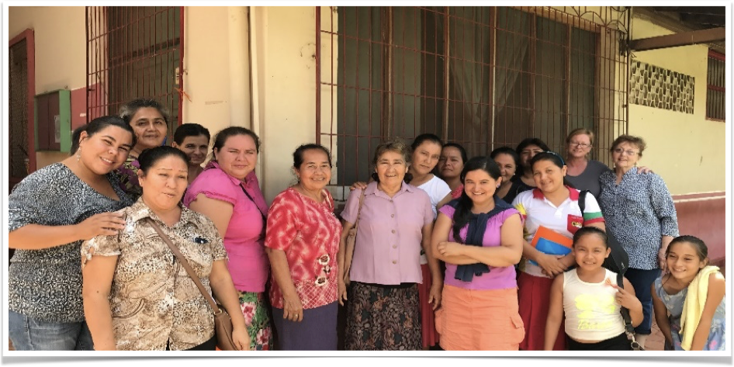
Multiplication from Bolivia to brazil to Argentina to tribes along amazon river

Slide 25
“The righteous will flourish like a palm tree, they will grow like a cedar of Lebanon; 13planted in the house of the Lord, they will flourish in the courts of our God. 14They will still bear fruit in old age, they will stay fresh and green, 15proclaiming, “The Lord is upright; he is my Rock, and there is no wickedness in him.”
–Psalms 92:12-15

Slide 26
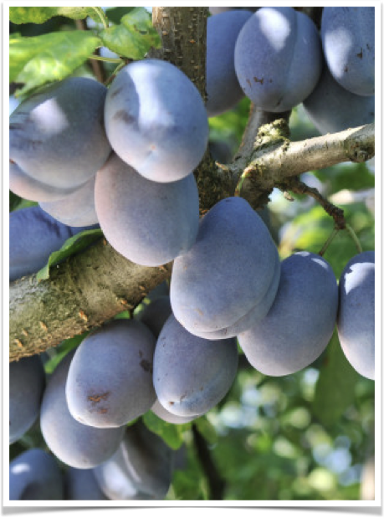
does a tree bear fruit for itself?
Why Does it bear fruit?

Slide 27
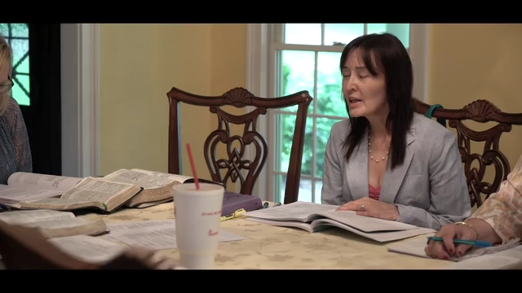
Be fruitful and Multiply

Slide 28
Disciple-making is…
Introducing people to the Heavenly Bridegroom - evangelism or Spiritual Matchmaking
Binding up the heart wounds in the body of Christ - equipping the saints
Building up the household of Christ - edifying the saints
Dressing up the bride of Christ in her wedding ensemble

Slide 29
The essential elements in the process
Connection between committed spiritual adults, such as Paul and Timothy, consistent communication, and using the exact same curriculum. Disciple-making happens in the context of accountable relationships

Slide 30
IN CONCLUSION
We have gathered to grow, been equipped to go do the ministry of reconciliation. Then, in life on life relationships in the body of Christ, we begin the ministry of binding up the body of Christ, building up His household, and dressing up His bride the church. Will you join us?

